Slide 1
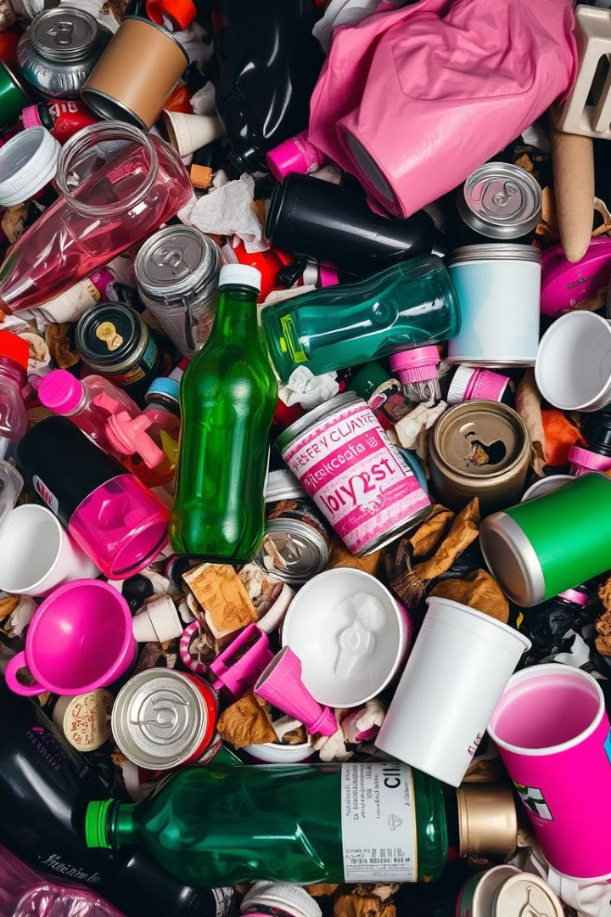
Trash Classification Using Machine Learning
Waste management is a critical aspect of environmental sustainability, and accurate trash classification plays a crucial role in efficient recycling and waste disposal.
Notes:
1

Slide 2

Introduction: Importance of Waste Management
1
Environmental Impact
2
Resource Conservation
Improper waste disposal contributes to pollution, greenhouse gas emissions, and habitat destruction.
Recycling valuable materials reduces the need for extraction of new resources.
3
Public Health
Efficient waste management prevents the spread of diseases and improves sanitation.
Notes:
2

Slide 3
Problem Statement: Accurate Trash Identification
Manual Sorting
Inconsistent Labeling
Environmental Concerns
Manual sorting is time-consuming, labor-intensive, and prone to human error.
Variations in trash types and labeling practices can lead to inaccurate classification.
Misclassified waste can contaminate recycling streams and reduce the effectiveness of waste management systems.
Notes:
3

Slide 4

Proposed Solution: Computer Vision Techniques
Image Recognition
Real-Time Processing
Computer vision algorithms can automatically identify and classify different types of trash based on visual features.
Real-time classification allows for immediate feedback and efficient sorting at waste collection points.
Data-Driven Approach
Machine learning models can continuously learn and improve their accuracy with more data.
Notes:
4

Slide 5
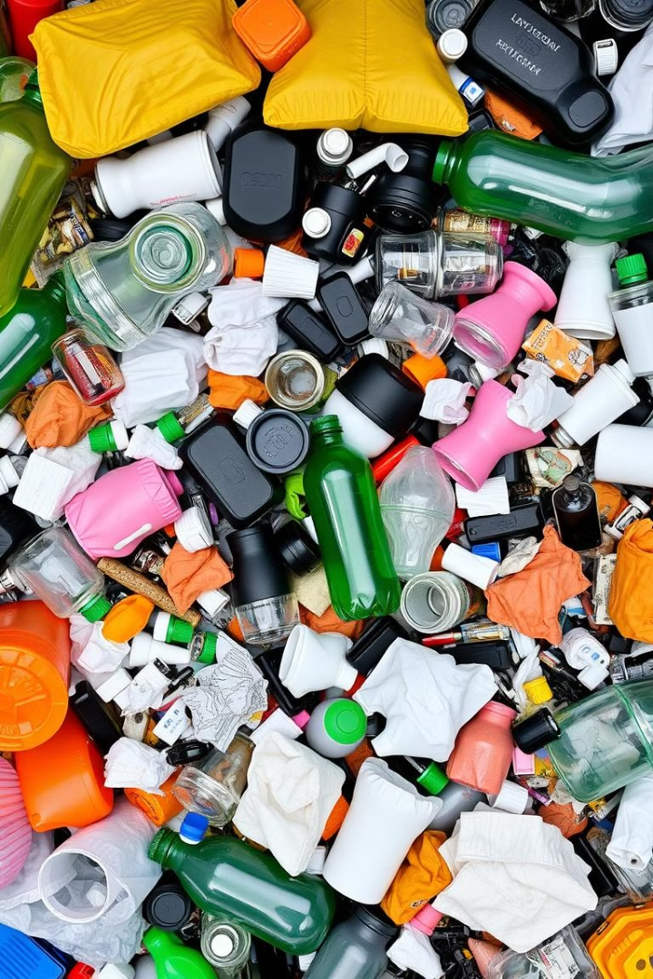
Data Collection and Preprocessing
1
Image Acquisition
Collecting a large and diverse dataset of images representing different types of trash is crucial for model training.
2
Data Augmentation
Enhancing the dataset by applying transformations such as rotation, scaling, and flipping can improve model robustness.
3
Labeling and Annotation
Accurately labeling each image with the corresponding trash category is essential for supervised learning.
Notes:
5

Slide 6

Convolutional Neural Network (CNN) Architecture
Layer Type
Function
Convolutional Layer
Extract features from the input image using kernels.
Pooling Layer
Reduce the dimensionality of the feature maps and prevent overfitting.
Fully Connected Layer
Combine features from different layers and make a final prediction.
Notes:
6

Slide 7
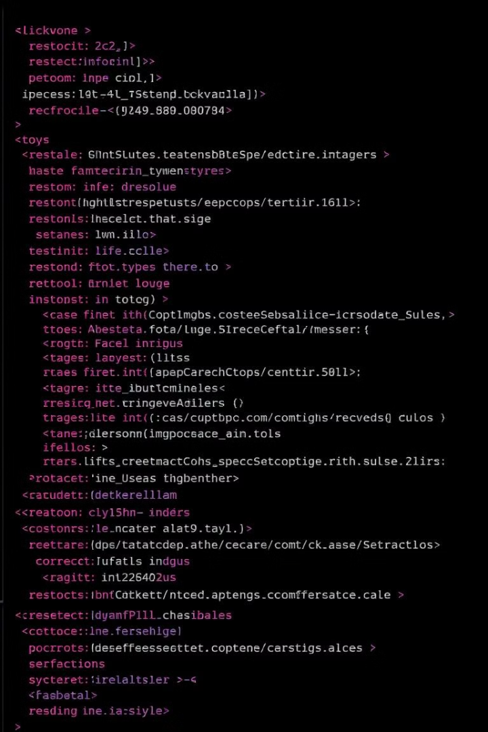



Image Processing with Python Imaging Library (PIL)
Image Loading
PIL provides functions to load images from various file formats.
Image Resizing
Resizing images to a consistent size is important for model training.
Image Conversion
PIL allows for conversion between different image formats and color spaces.
Notes:
7

Slide 8




Numerical Operations with NumPy
Array Representation
NumPy allows for efficient storage and manipulation of image data as multi-dimensional arrays.
Matrix Operations
NumPy provides a wide range of mathematical functions for performing operations on arrays.
Vectorization
Vectorized operations significantly improve the efficiency of image processing tasks.
Notes:
8

Slide 9
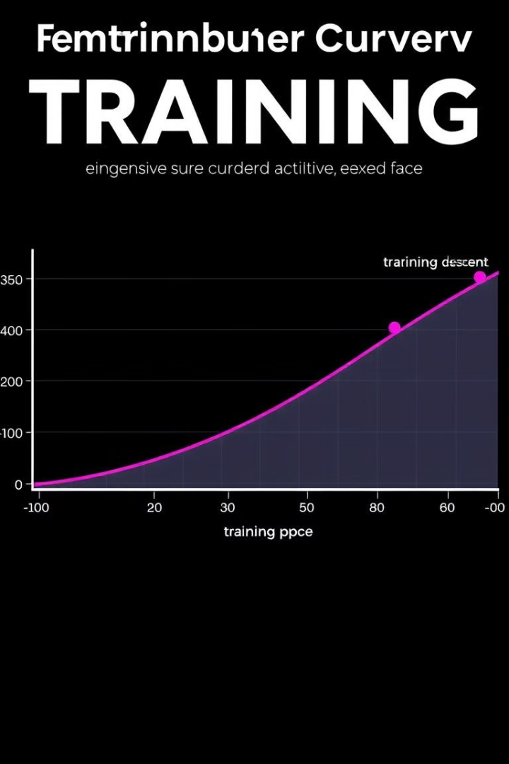
Model Training and Optimization
1
Backpropagation
2
Hyperparameter Tuning
The model learns by adjusting its parameters to minimize the difference between predicted and actual labels.
Optimizing hyperparameters such as learning rate and batch size can improve model performance.
3
Regularization
Techniques like dropout and weight decay prevent overfitting and improve generalization.
Notes:
9

Slide 10


Evaluation on Test Images
Plastic Bottle
Glass Jar
The model correctly identifies the plastic bottle with a prediction probability of over 90%.
The model correctly identifies the glass jar with a prediction probability of over 90%.
Notes:
10

Slide 11
Team Members
Rudraraju sathvik varma
Leena kaushik
Bhavya bhutani
E23CSEU0439
E23CSEU0444
E23CSEU0123
Thank You
We would like to express our sincere gratitude for your interest in our project. Your feedback and support have been invaluable.
Notes:
11

